Slide 1
Distributed File Systems and Name Services
6.1 Introduction and features of DFS,
File models, File Accessing models,
File-Caching Schemes, File Replication,
Case Study: Distributed File Systems (DSF),
Network File System (NFS),
Andrew File System (AFS)
6.2 Introduction to Name services and Domain Name System, Directory Services,
Case Study: The Global Name Service,
The X.500 Directory Service
6.3 Designing Distributed Systems: Google Case Study

Slide 2
Distributed File System
file storing on server ,deleting editing then to manage that file how server does ?
to manage file on server ...dfs does. it is client based application which gives permission to access and process data which is stored on server .
when user access file on server then server send one copy of file to user .like os ,using file management system arranges files.like that DS to track files a uniform naming convention and mapping scheme uses. when client retrieves file from server ....
NFS
Hadoop

Slide 3
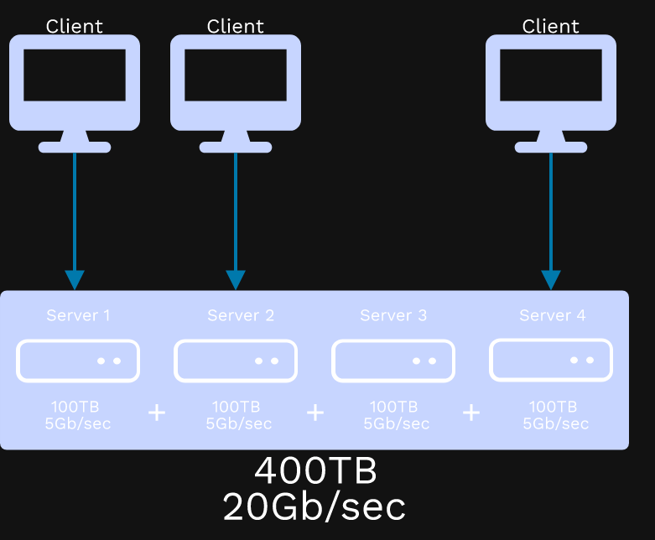

Slide 4
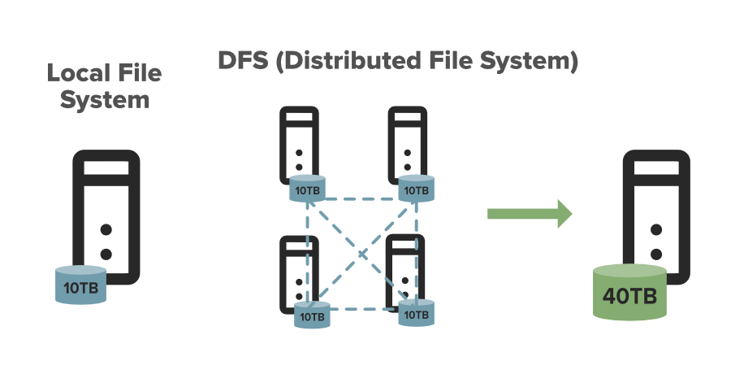

Slide 5
DFS allows multiple user to access or store the data.
It allows the data to be share remotely.
It improved the availability of file, access time, and network efficiency.
Improved the capacity to change the size of the data and also improves the ability to exchange the data.
Distributed File System provides transparency of data even if server or disk fails
A distributed system is composed of several servers connected via a computer network - like ethernet or the internet
DFS (distributed file system), as the name suggests, is a file system that is distributed across multiple file servers or multiple locations. DFS's primary goal is to enable users of physically distributed systems to share resources and information through the Common File System (CFS)

Slide 6
Desirable features of DFS
Transparency: hide information from user
1)Structure Transparency: user stores data on server . but behind multiple copies of user data created and these multiple copies stored on multiple servers.so user should not get multiple copies of data created and stored on multiple(how many) servers and their locations.
Clients should not know the number or locations of file servers or the storage devices instead it should look like a conventional file system (Centralize System)
2)Access Transparency: local files stored inside computer. Remote files store on server. With ease user able to access files on local computer with same ease user able to access files on remote server. Local and remote files should be accessible in the same way
3)Naming transparency: when file moves from one computer to another computer ,name of file should not change.
4)Replication Transparency:multiple copies of user file created should not known to user and on which locations. The existence of multiple copies and their locations should be hidden from the clients

Slide 7
scalability:number of users and nodes in a network in DS should scale up . always increasing. A good DFS should cope with an increase of nodes and not cause any disruption of service. Scalability also includes the system to withstand high service load, accommodate growth of users and integration of resources.
High availability(replication): if any node fails or storage device crashed still DS will work like normal .
HIgh Reliability: probability of losing/loosing stored data .sytem automatically keeps backup copy of files which may corrupt or loose at time of failure.
Data Integrity: since shared files used by multiple users so integrity of data within file should not affect.

Slide 8
Security: data protected from unauthorized access using multiple security mechanism
User mobility:The user should not be forced to work on a specific node but should have the flexibility to work on different nodes at different times. This can be achieved by automatically bringing the users environment to the node where the user logs in
Heterogeneity: different machines have different OS.
performance: performance should be same as centralized System. it is measured as the average amount of time needed to satisfy client requests, which includes CPU time plus the time for accessing secondary storage along with network access time.
Fault tolerance: continue to provide correct service in the presence of communication or server faults

Slide 9
File Models in DFS
In the unstructured model, a file is an unstructured sequence of bytes. The interpretation of the meaning and structure of the data stored in the files is up to the application (e.g. UNIX and MSDOS). Most modern operating systems use the unstructured file model.
Examples of unstructured data include text, video files, audio files, mobile activity, social media posts, satellite imagery,– the list goes on and on.
In structured files (rarely used now) a file appears to the file server as an ordered sequence of records.
Examples of structured data include names, dates, addresses, credit card numbers, stock information, geo-location, and more.
Structured data is highly organized and easily understood by machine language. Those working within relational databases can input, search, and manipulate structured data relatively quickly using a relational database management system (RDBMS).

Slide 10
Mutable and immutable files Models
Based on the modifiability criteria, files are of two types, mutable and immutable.
Most existing operating systems use the mutable file model. An update performed on a file overwrites its old contents to produce the new contents.
In the immutable model, rather than updating the same file, a new version of the file is created each time a change is made to the file contents and the old version is retained unchanged. The problems in this model are increased use of disk space and increased disk activity.

Slide 11
File Accessing Models
The specific client's request for accessing a particular file is serviced on the basis of the file accessing model used by the distributed file system.
The file accessing model basically depends on 1 ) the unit of data access and 2 ) the method used for accessing remote files.
On the basis of the unit of data access, following file access models might be used in order to access the specific file.
File-level transfer model
Block-level transfer model
Byte-level transfer model
Record-level transfer model

Slide 12
1File-level transfer model: In file-level transfer model, the complete file is moved while a particular operation necessitates the file data to be transmitted all the way through the distributed computing network amongst client and server. This model has better scalability and is efficient.
2.Block-level transfer model: In block-level transfer model, file data transfers through the network amongst client and a server is accomplished in units of file blocks. In short, the unit of data transfer in block-level transfer model is file blocks. The block-level transfer model might be used in distributed computing environment comprising several diskless workstations.

Slide 13
3.Byte-level transfer model: In byte-level transfer model, file data transfers the network amongst client and a server is accomplished in units of bytes. In short, the unit of data transfer in byte-level transfer model is bytes. The byte-level transfer model offers more flexibility in comparison to the other file transfer models since, it allows retrieval and storage of an arbitrary sequential sub range of a file. The major disadvantage of byte-level transfer model is the trouble in cache management because of the variable-length data for different access requests.
4.Record-level transfer model: The record-level file transfer model might be used in the file models where the file contents are structured in the form of records. In record-level transfer model, file data transfers through the network amongst client and a server is accomplished in units of records. The unit of data transfer in record-level transfer model is record.

